Slide 1

Dallas College
Building Capacity with Dallas College Business Opportunities
Jeanette Schutz

Slide 2







DALLAS COLLEGE SCHOOLS

Slide 3
Agenda
Jaggaer System (e-Procurement)
How to do Build Your Capacity
Purchasing Processes
Bond Program
Cooperative Agreements
Business Diversity Program
Certification
Questions & Answers

Slide 4
Jaggaer
Supplier Registration
Jaggaer Total Supplier Registration
Login – www.dcccd.edu/purchasing
Dallas College Purchasing Web site
JaggaerTSM@dcccd.edu
Telephone (972) 860-7917

Slide 5
Jaggaer
Sourcing
RFP’s, RFQ’s, and Bids are solicited electronically
Suppliers can view and download solicitations from the site
Proposal and Bid submittals uploaded electronically to Jaggaer Sourcing
Suppliers notified via site of any addendums and questions

Slide 6
How to do business
Purchasing guidelines determined by the state legislative and Dallas College policy
Goods & Services (RFB)
Non-Professional Service (RFP)
Professional Service (RFP/RFQ)
Contract Pricing Listing
State purchasing contracts
Cooperative purchasing agreements
Notes:
How does that work?
Any quote, proposal or bid under $24,999 will be signed off by the Chief of Procurement person
Any quote, proposal or bid over $50,000 will be signed off by the Chief of Financial
Any quote, proposal or bid over $100, 000 will be sign off by the Chancellor

Slide 7
What we Buy
Advertising Specialties
Automotive Eqpt/Parts
Carpet Cleaning Svc
Fuel, Oil & Lubricants
HVAC Eqpt/Repair Svc
Laboratory Chemicals
Painting & Drywall Svc
Professional services
Uniforms
Unarmed Security
Printing
Promotional items
Trophies/Awards
Roofing Repair Svc
Tradesmen Svc
Building Maintenance
Voice/Data Cable
Installation
Welding/Metal Work Svc
And much more…..
Notes:
How does that work?
Any quote, proposal or bid under $24,999 will be signed off by the Chief of Procurement person
Any quote, proposal or bid over $50,000 will be signed off by the Chief of Financial
Any quote, proposal or bid over $100, 000 will be sign off by the Chancellor

Slide 8
Procurement Opportunities
Construction Projects
Contract Pricing Agreement (CPI’s)
Goods and Services
Trades Agreement
Architecture/Engineering
Professional Services
Contracts under $10k

Slide 9

Construction Services
Construction of New Campuses
Maintenance and Renovation of Existing Campuses
(roofing, cooling towers, elevator upgrades, central plant, sidewalks, lighting, drainage, pools, etc.)
Pre-Bid Meetings
Pre-Construction Meetings

Slide 10

Cooperative Agreements
Buyboard
Choice Partners Cooperative
DIR – Department of Information Resources
Sourcewell
E&I Cooperative Services
TIPS – The Interlocal Purchasing System
TCPN – The Cooperative Purchasing Network
TXMAS
U.S. Communities
This Photo by Unknown Author is licensed under CC BY-SA

Slide 11
Advertisement of Bids
Dallas College Purchasing web site
Name of the Bid
Date & Time Bid is Due
Location to turn in the Bid or Proposal – Jaggaer Sourcing
Buyer Responsible for the Bid or Proposal
Construction Bids: Mandatory Virtual Meeting
Advertised in the Dailey Commercial Records/Online
Bid Advertised for 2 weeks

Slide 12
Bond Program
Dallas College has a $1.1 billion bond program passed by the citizens of Dallas County for the 7 Campuses and other buildings.
Dallas College - construction projects are in 3 phases and other services.
Presently we are on Phase 1.
7-10-year bond program

Slide 13
Diverse Certification
North Central Texas Regional Certification Agency
Dallas/Fort Worth Minority Supplier Development Council
Women’s Business Council – Southwest
Historically Underutilized Businesses
LGBTQ
Veterans
Small Business Enterprise (SBE)
Disadvantaged Business Enterprise (DBE)

Slide 14
C.E.O Approach
Collaboration
Education
Opportunity

Slide 15

Questions and Answers

Slide 16
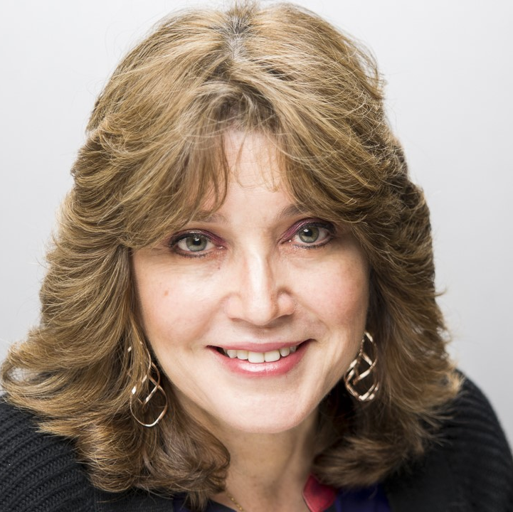
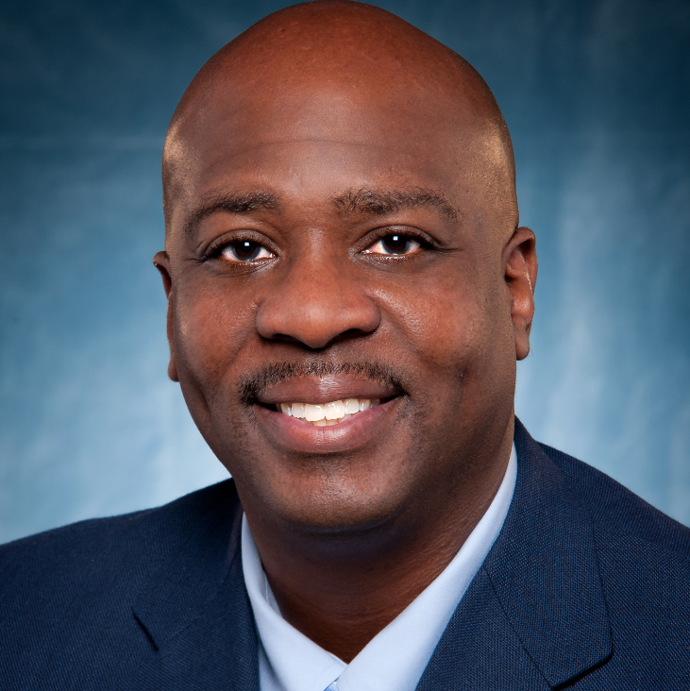
Contact Information
Jeanette Schutz
Senior Director Supplier Diversity
JSchutz@dcccd.edu
214-860-5901
Malcom Mayo
Director Supplier Development
Malcolm.mayo@dcccd.edu
972-860-7706

